Slide 1
Predict Future Sales
Data Analytics with R Final Project
Members:
Gayatri Manoj Khairnar (gk363)
Mathangi Suresh (ms2957)
Naganathan Meenakshi Sundareswaran (nm749)

Slide 2
Description of Problem
We need to forecast the to predict total sales for every product and store in the next month, for the test set provided.
The challenge is to find an algorithm for prediction which given greatest accuracy.

Slide 3
Data Used
sales_train.csv - the training set. Daily historical data from January 2013 to October 2015.
test.csv - the test set. You need to forecast the sales for these shops and products for November 2015.
sample_submission.csv - a sample submission file in the correct format.
items.csv - supplemental information about the items/products.
item_categories.csv - supplemental information about the items categories.
shops.csv- supplemental information about the shops.

Slide 4
Our Approach
Random Forest Tree Algorithm
Ada Boost Algorithm
XGBoost Algorithm
LightGBM
Notes:
https://arxiv.org/ftp/arxiv/papers/1904/1904.09031.pdf

Slide 5
Data Cleaning
1. Checking missing values
2. Remove outliers
3. Remove data instances with negative price or item count
4. Combine duplicate feature values into a single feature value

Slide 6
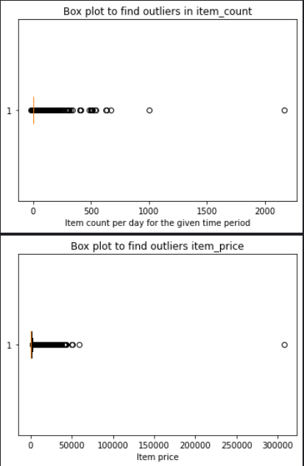
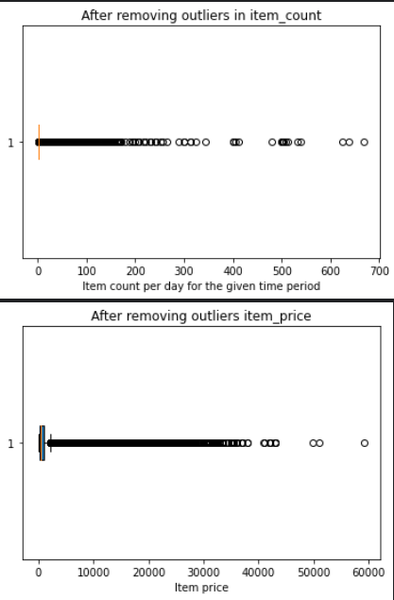
Checking and removing Outliers

Slide 7
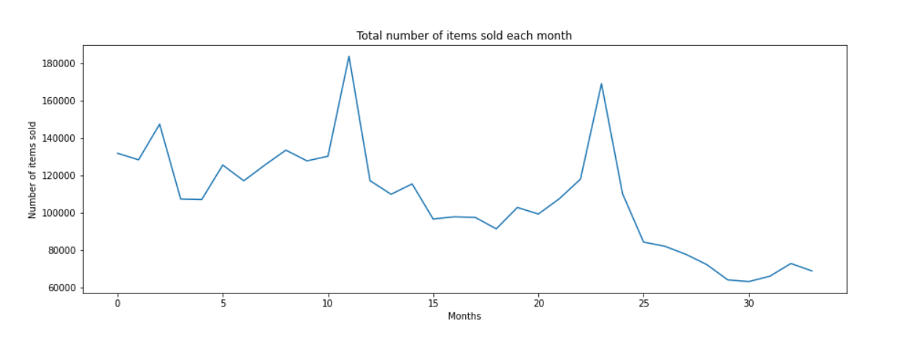
Total number of items sold each month

Slide 8
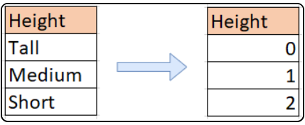
Label Encoding
Data is represented as a number instead of categorical
To convert the categorical data to numerical representation
Why?
Well, most of the machine learning algorithms will not understand, or not be able to deal with categorical variables
Method which is used to encode the categorical data: LabelEncoder() from scikit-learn library

Slide 9
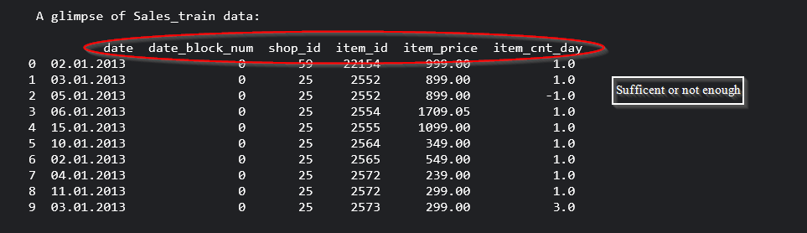
Feature Selection
To help the model understand and perform better from the collected data
Not all the data are useful and sometimes the data are insufficient and new need to be derived from the available data

Slide 10
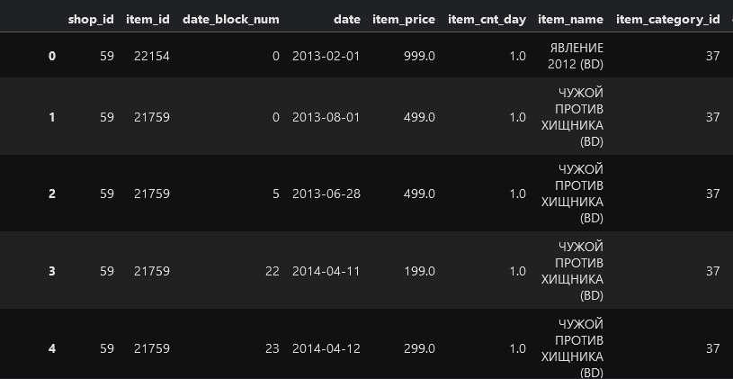
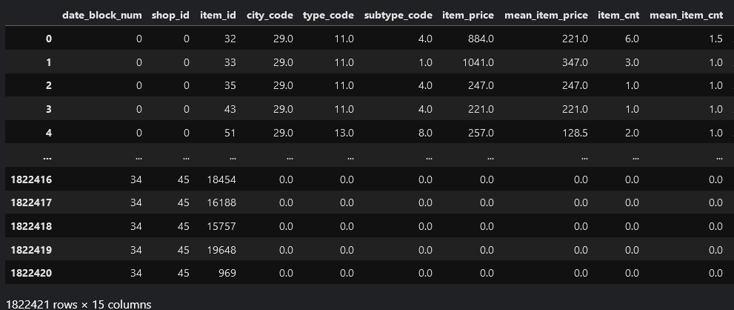
Feature Selection (continued)

Slide 11
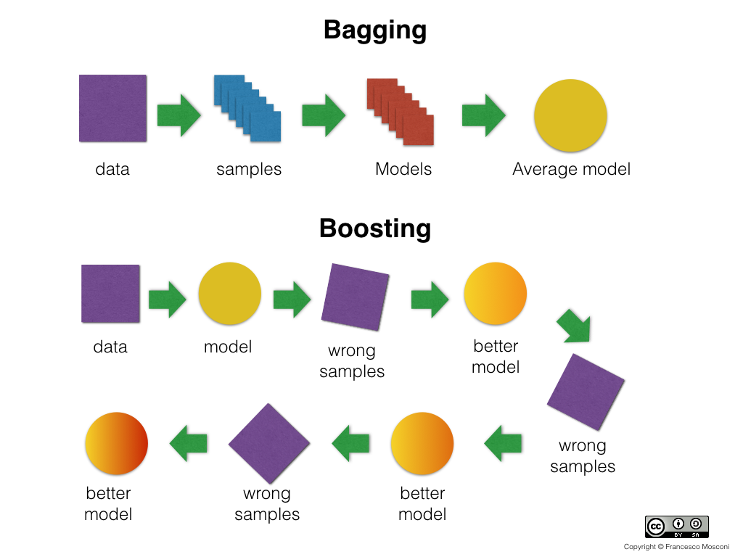

Slide 12
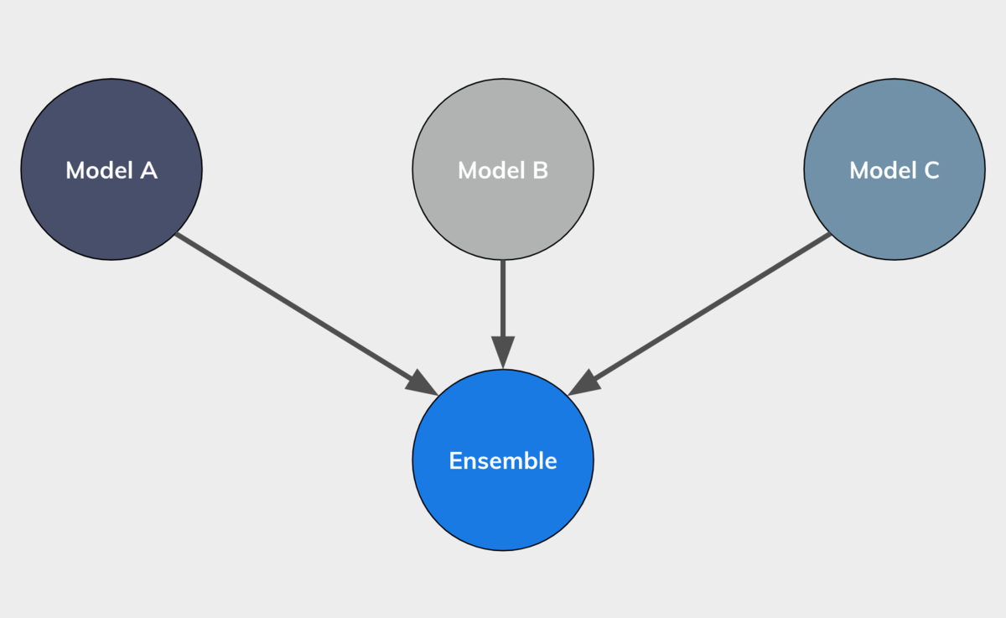
Ensemble Technique

Slide 13
Random Forest Algorithm
Random Forest is a classifier that contains several decision trees on various subsets of a given dataset and takes the average to enhance the predicted accuracy of that dataset.
Instead of relying on a single decision tree, the random forest collects the result from each tree and expects the final output based on the majority votes (if it is a classification) or average votes (if it is a regression).

Slide 14
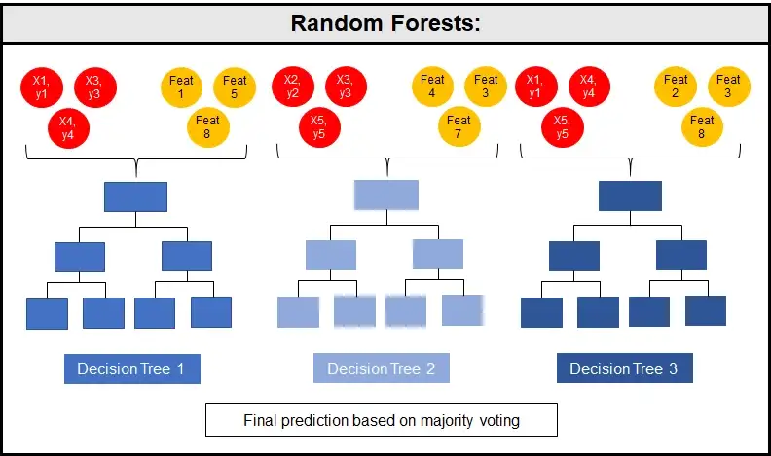

Slide 15
Let us assume that there are m features and n records in a dataset.
Initially, some sample rows and sample features are selected to create the first decision tree.
Here, the algorithm allows row sampling and feature sampling with replacement.
The same process is repeated for i number of times to create i DTs.
After this is done, when a validation set or test data is passed, we get a predicted value from all these DTs.
The majority vote / avg vote is selected.
Low bias: When a DT is created to it’s complete depth, then it will get properly trained for the training dataset.
High variance: When we get a new data (test), trees are prone to give high errors.
So, when a tree is created to complete depth, it created overfitting problem.

Slide 16
But, when DTs are combined to get one output, this high variance is converted into low variance.
This is because, DTs gets trained in way that it correctly classifies for data (and similar) for which it has been trained.
Another advantage of this algorithm is that, if there is any change in the values of certain records, or a very minimal number of outliers, it will not affect the model.

Slide 17
We finally calculated the RMSE (Root Mean Square Error) for the trained model. This is a a metric that tells us how far apart our predicted values are from our observed values in a model, on average.
It is calculated as: RMSE = √Σ(Pi – Oi)2 / n
where:
Σ is a fancy symbol that means “sum”
Pi is the predicted value for the ith observation
Oi is the observed value for the ith observation
n is the sample size
It is a value between 0 and 1. We tried to maintain the RMSE value close to 0, which means that predicted values of the model is as close to the actual / observed values in the dataset as possible.

Slide 18
Ada Boost Algorithm
Adaptive boosting is a Boosting technique used as an Ensemble Method in Machine Learning.
It is called Adaptive Boosting as the weights are re-assigned to each instance, with higher weights assigned to incorrectly classified instances.
It works on the principle of learners growing sequentially.

Slide 19
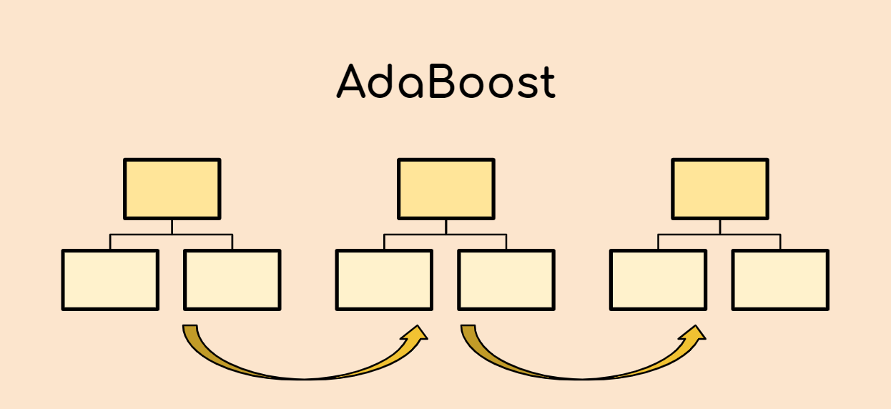

Slide 20
Let us assume that there are m features and n records in a dataset.
A sample weight of w = 1/n (initial) is assigned to all the records.
Then, the first base learner is created. Here, all the BL are decision trees. These trees are called stomps since the depth of the decision tree is 1.
Stomps are created for every feature.
Then entropy is calculated for all these stomps. The least entropy among the features would be selected as the BL model for the first sequence.
This BL1, we find the number of correctly classified and misclassified records.
For the misclassified records, we will calculate the total error. TE = No of misclassified records / n

Slide 21
We then calculate the performance of this base learner. Performance = ½ (log e((1-TE)/TE))
Since, only the misclassified records will be passed to the next stomp, we need to update the weights before proceeding to the next step. To do so, we need the TE and Performance of the BL model.
The weights of the misclassified records is increased and the correctly classified records is decreased.
For misclassified records, new wt = Old wt * e^Perfmce
For other records, new wt = Old wt * e^ -Perfmce
We now calculate the normalized weights. This is because, when we sum the weights after updation it is not =1 unlike the initial weight. So, we divide these weights by it’s sum.
For creating the next BL, weight buckets are created by the algorithm. It then selects the records with weights within that bucket.

Slide 22
Now that we have i BL, when we pass the validation dataset or the test dataset through these i BL, we get the output and the majority is selected as the prediction value.
We combine multiple weak learners to make one strong learner.
This is the ensemble model.

Slide 23
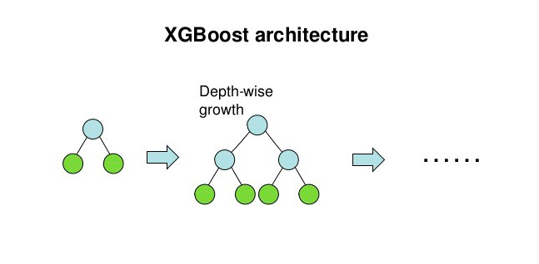
XGBoost - Extreme Gradient Boosting

Slide 24
Used for the implementation of gradient boosting decision trees.
XGBM implements parallel preprocessing at the node level itself.
It is 10 times faster than any of the existing gradient boosting algorithms.
XGBoost also includes a variety of regularization techniques that reduce overfitting and improve overall performance.
The XGBM model can handle the missing values on its own.

Slide 25
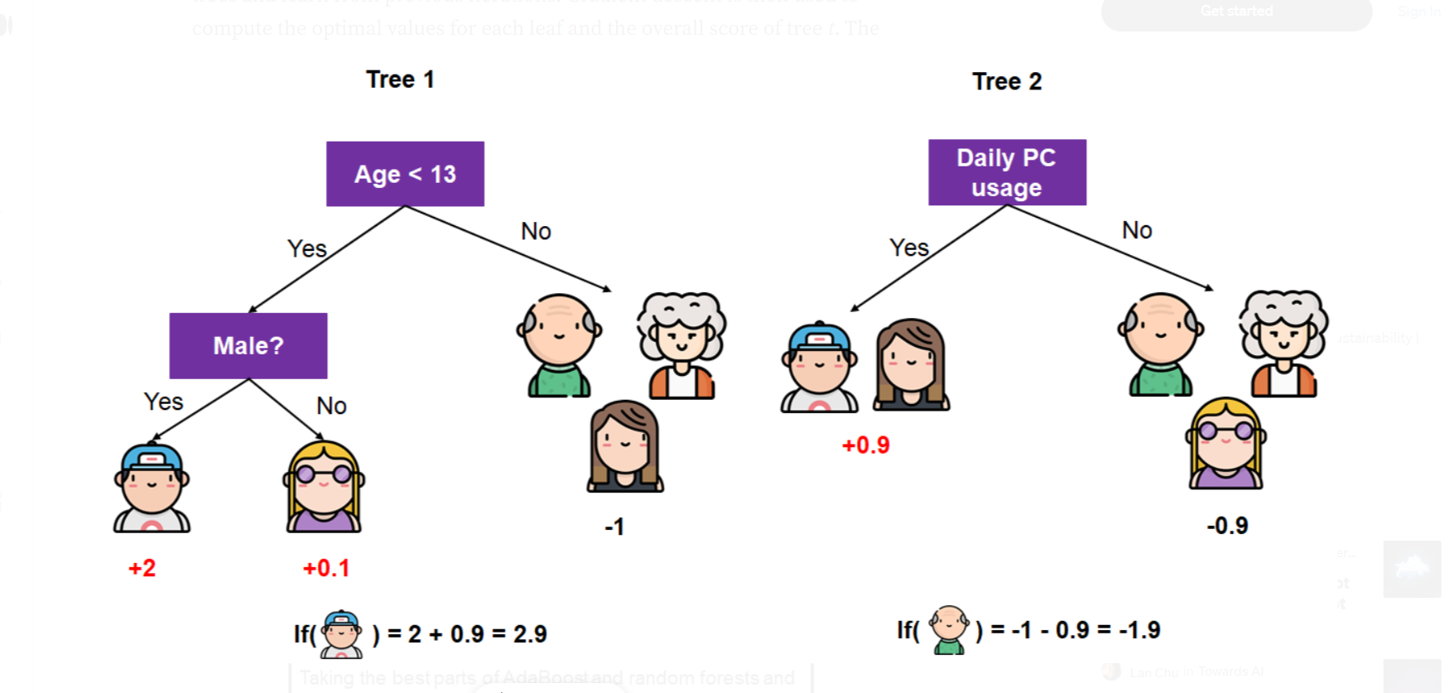

Slide 26
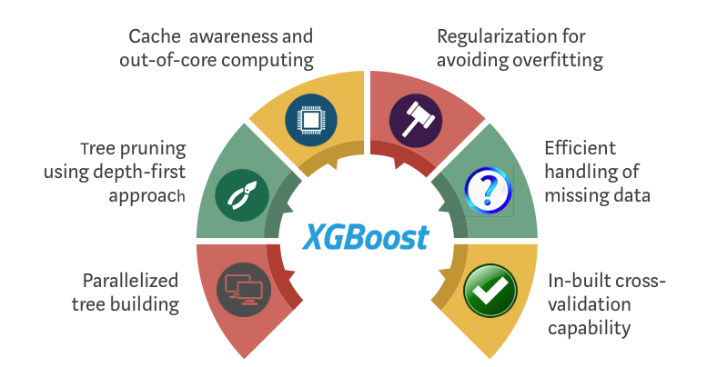

Slide 27
Light GBM (Light Gradient-Boosting Machine)
It is based on decision tree algorithms
LightGBM uses a novel technique of Gradient-based One-Side Sampling (GOSS) to filter out the data instances for finding a split value
It splits the tree leaf wise with the best fit whereas other boosting algorithms split the tree depth wise or level wise rather than leaf-wise
The leaf-wise algorithm can reduce more loss than the level-wise algorithm and hence results in much better accuracy which can rarely be achieved by any of the existing boosting algorithms
Notes:
https://www.kdnuggets.com/2018/03/catboost-vs-light-gbm-vs-xgboost.html
https://www.analyticsvidhya.com/blog/2020/02/4-boosting-algorithms-machine-learning/

Slide 28
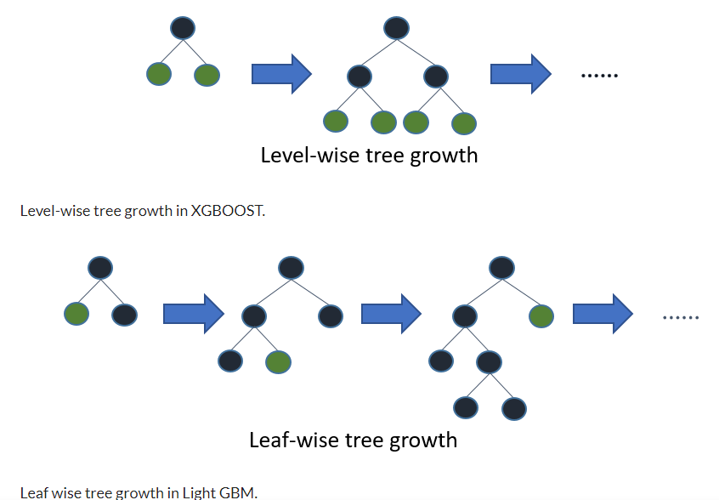
LightGBM (continued)
Notes:
The basic assumption taken here is that samples with training instances with small gradients have smaller training error and it is already well-trained.
In order to keep the same data distribution, when computing the information gain, GOSS introduces a constant multiplier for the data instances with small gradients. Thus, GOSS achieves a good balance between reducing the number of data instances and keeping the accuracy for learned decision trees.

Slide 29
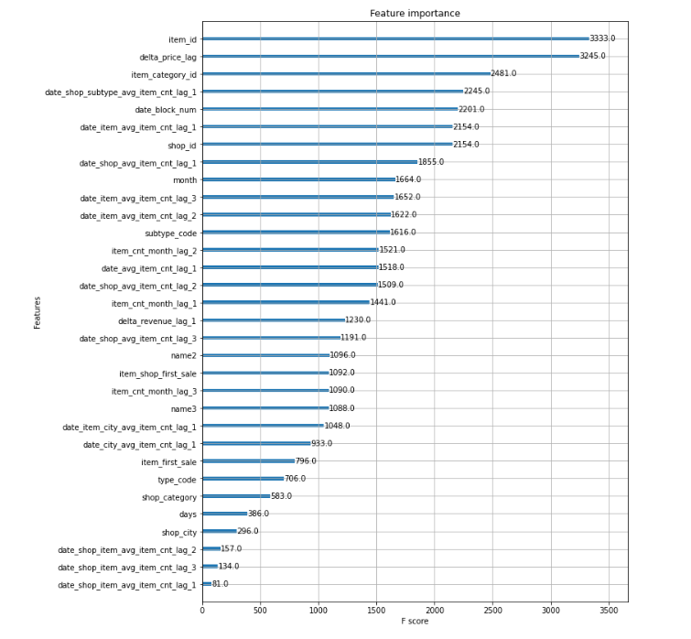

Slide 30
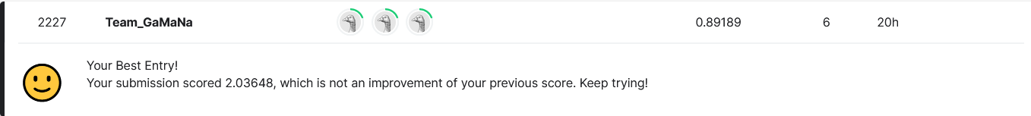
Score on Kaggle leaderboard

Slide 31
Thank You!

